Slide 1

SMART ROLE-BASED EMPLOYEE MANAGEMENT SYSTEM
Batch - 08
K. Bhaavya Pranathi (22221A0540)
K. Rajasri (22221A0550)
CH. Pheobe Jyothi (22221A0524)
K. Indrani (22221A0552)
Project Guide : G. Santhoshi Lakshmi
Department : Department of computer science and engineering
College : BVC Engineering College , Odalarevu

Slide 2
INTRODUCTION
Employee Management System(EMS) is a web-based application developed to manage employee data efficiently.
It helps in maintaining employee records, attendance, and organizational hierarchy in a structured way.
The system provides secure role-based access to different users such as Admin, HR, and Employee.
It replaces traditional manual systems like paper records and Excel sheets.
The application is developed using Java Full Stack technologies for better performance and scalability.

Slide 3
PROBLEM STATEMENT
Many organizations still depend on manual record-keeping and Excel sheets to manage employee data.
These methods lead to data redundancy, inconsistency, and human errors.
Lack of proper authentication and access control causes security issues.
Managing employee records becomes difficult as the organization grows.
There is a need for a centralized and secure system to handle employee management efficiently.

Slide 4
OBJECTIVES
To design and develop a scalable employee management system.
To implement role-based access control for secure system usage.
To automate employee record management and attendance tracking.
To reduce manual work and improve data accuracy.
To provide a user-friendly and responsive interface for all users.

Slide 5
EXISTING VS PROPOSED SYSTEMS
Feature | Existing Manual/Excel system | Proposed Role-Based EMS
Data Storage | Dispersed across manual files or various Excel sheets. | Centralized database acting as a single repository.
Access Control | No formal restrictions; anyone with the file can see everything. | Role-based access (Employee, HR, Admin) ensures data privacy.
Data Integrity | High risk of redundancy, typos and inconsistent versions. | Single source of truth; validation rules prevent duplication.
Efficiency | Time-consuming manual entry and cross-referencing. | Real-time update and automated workflows.
Security | Low; files can be easily copied, deleted, or shared. | Secure encryption and controlled permissions.
Management | Difficult to track history or generate reports. | Simplified management with instant search and reporting.

Slide 6
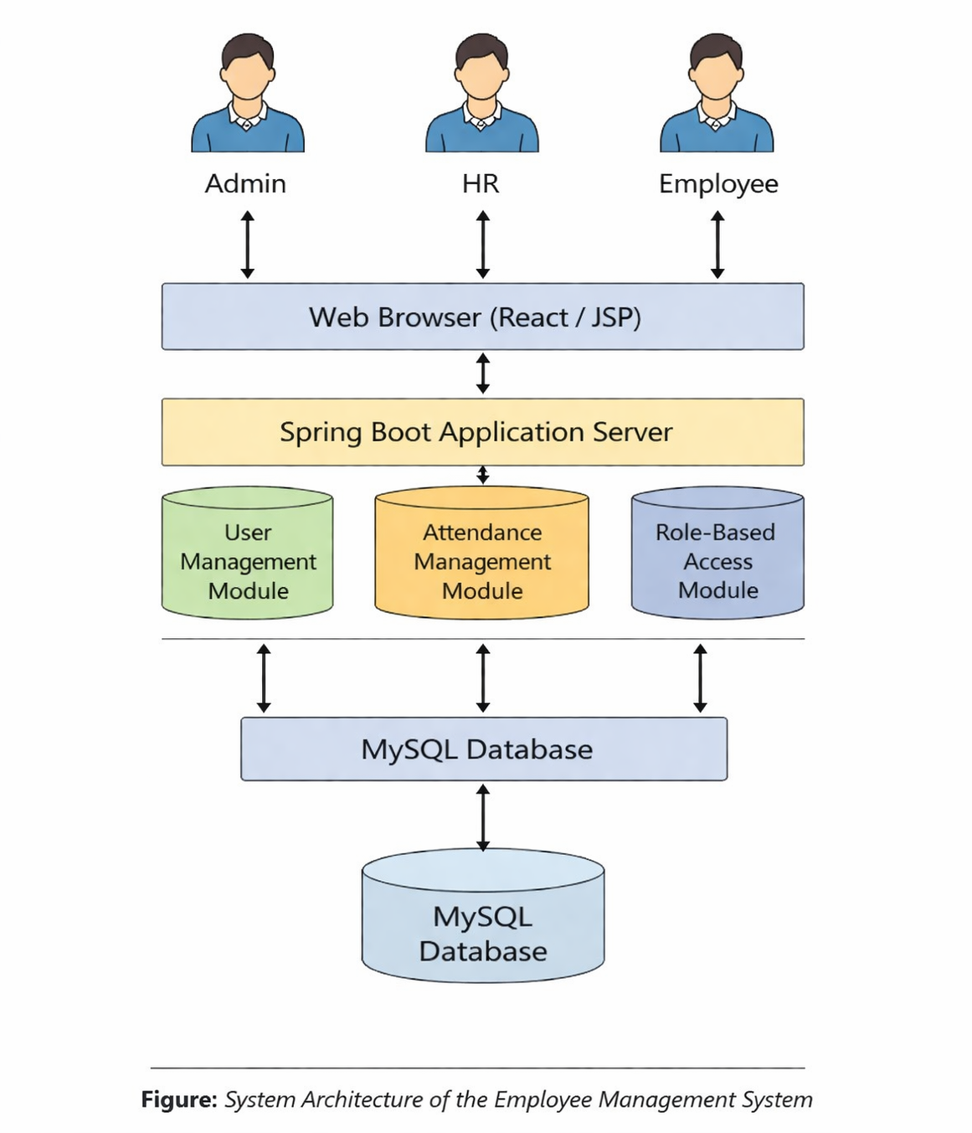
SYSTEM ARCHITECTURE
The system follows a three-tier architecture consisting of frontend, backend, and database.
The frontend is developed using React to provide an interactive user interface.
The backend is developed using Spring Boot to handle business logic and APIs.
MySQL database is used for storing and managing employee data.
REST APIs are used to enable communication between frontend and backend.

Slide 7
TECHNOLOGY STACK
Frontend :
React JS
HTML, CSS, JavaScript
Backend :
Spring Boot
REST API s
Tools :
VS Code
Spring Tool Suite/Eclipse
MySQL Workbench
Postman
Database :
MySQL

Slide 8
MODULES
Admin Module : Responsible for managing users, assigning roles, and controlling the entire system
HR Module : Handles employee data, attendance management, and employee-related operations
Employee Module : Allows employees to view their profile, attendance, and assigned HR details
Authentication Module : Ensures secure login and restricts access based on user roles

Slide 9
SYSTEM WORKING FLOW
The user first enters login credentials such as username and password
The system verifies these credentials from the database
After successful login, the user is redirected to their respective dashboard based on role
Each role has access to specific functionalities within the system
All user actions are processed through backend APIs and stored in the database

Slide 10
ROLE-BASED ACESS CONTROL
The system implements role-based access control to restrict unauthorized access
Admin has full control over the system including user management
HR can manage employees assigned to them and handle attendance
Employees have limited access to view their own details
No public registration is allowed, ensuring only authorized users can access the system

Slide 11
DATA FLOW OF THE SYSTEM
The frontend sends user requests to the backend through REST APIs
The backend processes the request using business logic
Data is stored or retrieved from the MySQL database
The processed response is sent back to the frontend and displayed to the user
This ensures smooth communication between all system components

Slide 12
PROJECT DEVELOPMENT STEPS
Designed system architecture and identified system modules
Developed backend services using Spring Boot
Created database tables and relationships using MySQL
Built user interface using React components
Integrated frontend with backend using REST APIs
Tested the system using Postman and debugging tools

Slide 13
IMPLEMENTATION DETAILS
The system follows a layered architecture for better organization
Controller layer handles incoming HTTP requests
Service layer contains business logic and processing
Repository layer interacts with the database using JPA
REST APIs are used to connect frontend and backend seamlessly
This structure improves maintainability and scalability of the system

Slide 14
RESULTS
The system successfully implements secure login functionality
Admin dashboard allows complete control over users and system
HR dashboard enables efficient employee management and attendance tracking
Employee dashboard provides self-service features for users
Overall system works efficiently with accurate data handling

Slide 15
CONCLUSION & FUTURE SCOPE
Conclusion:
The system improves efficiency by automating employee management tasks
It reduces manual errors and ensures data accuracy
Role-based access enhances security and data protection
Provides a scalable solution for modern organizations
Future Scope:
Development of mobile application for easy access
Integration with cloud platforms for better scalability
Implementation of advanced analytics and reporting features

Slide 16
THANK YOU

